Slide 1


Slide 2

Introduction
In this EDA we are going to study the following:
- Foreign tourists in Spain VS Foreign Tourists in Andalusia
- National tourists in total VS National tourists in Andalusia
- Type of trips of foreign tourists VS Type of trips of national tourists
- Expenditure of foreign tourists VS Expenditure of national tourists

Slide 3
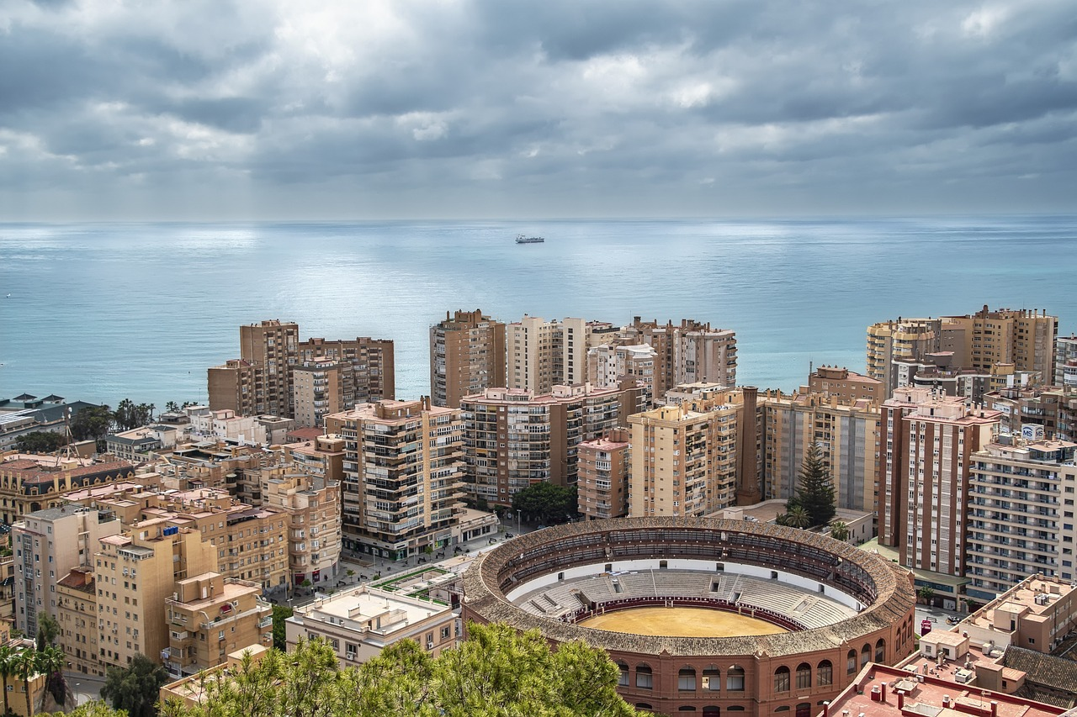
Hypothesis
With the data we will try to solve the following hypotheses:
- See the number of foreign and national tourists who visit Andalusia
- Check what type of trip prevails in Andalusia
- Which tourism leaves more profits, foreign or national?
- Make visible how the COVID-19 pandemic or Brexit affected tourism in Andalusia

Slide 4
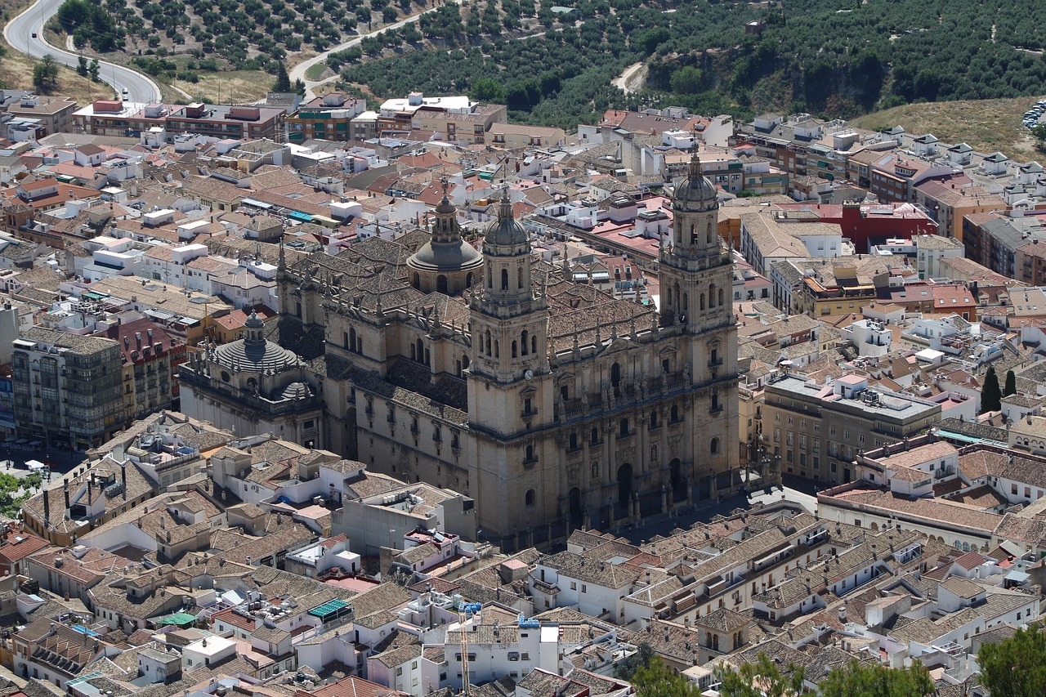
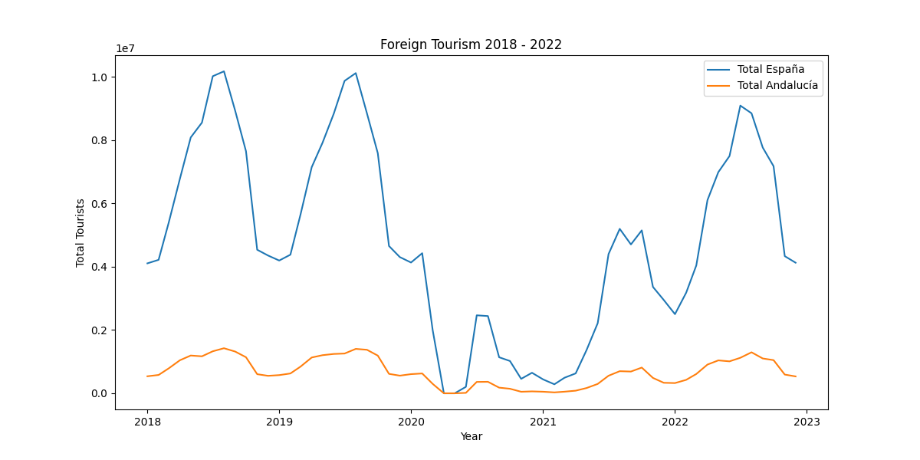
Foreigners in Spain VS Andalusia

Slide 5

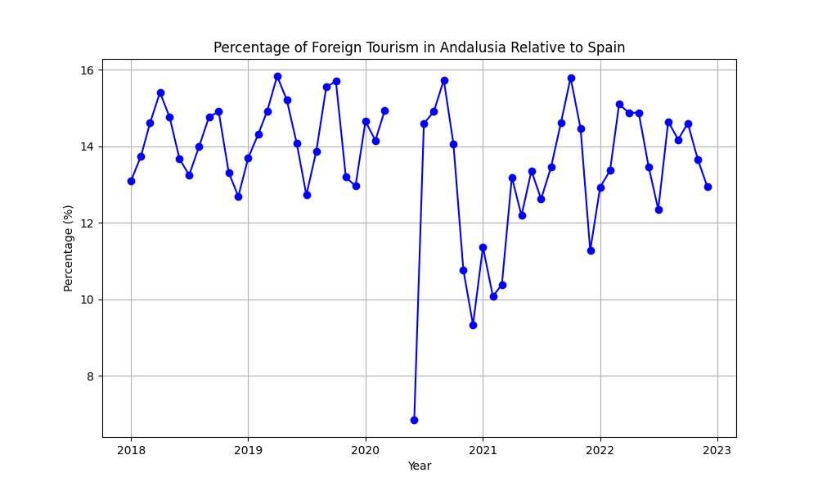
Foreigners in Spain VS Andalusia

Slide 6

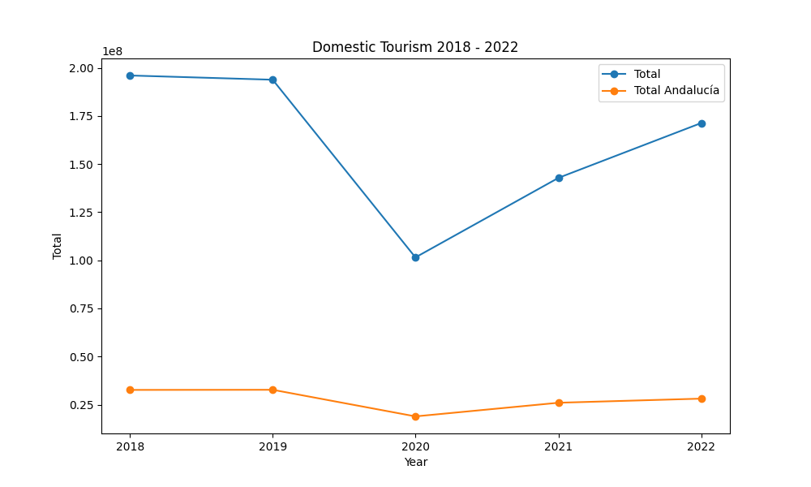
Nationals in total VS Andalusia

Slide 7
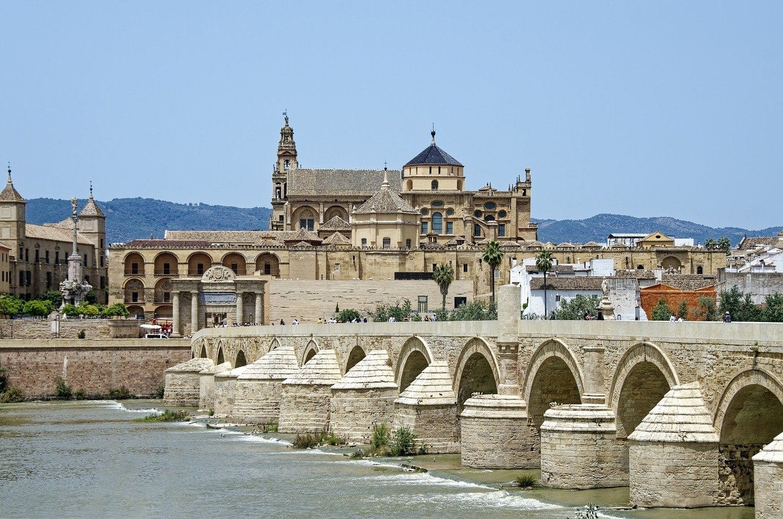
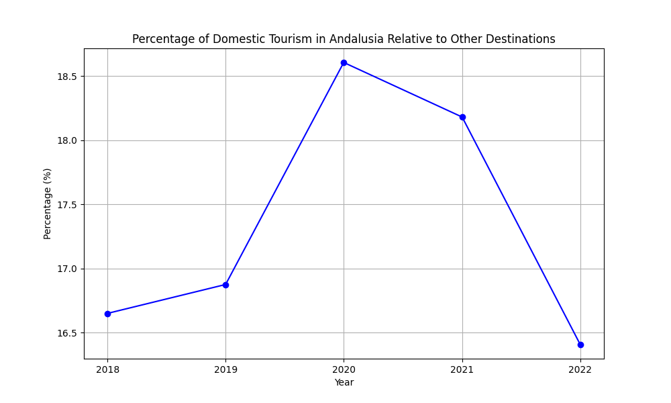
Nationals in total VS Andalusia

Slide 8

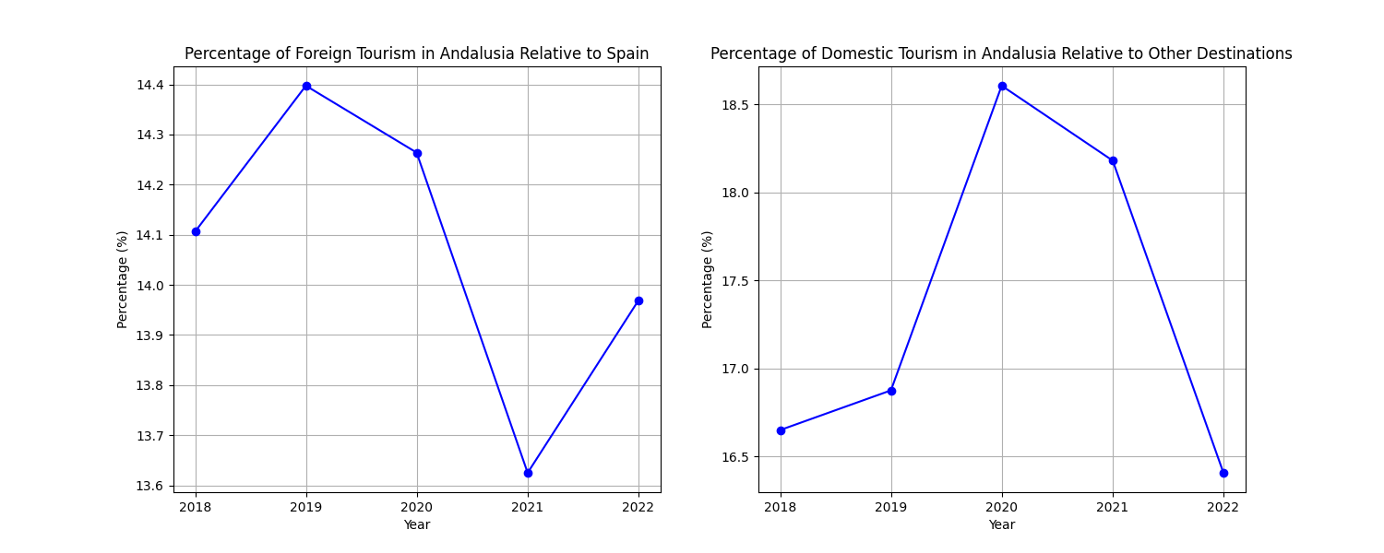
Foreign VS National Percentage

Slide 9

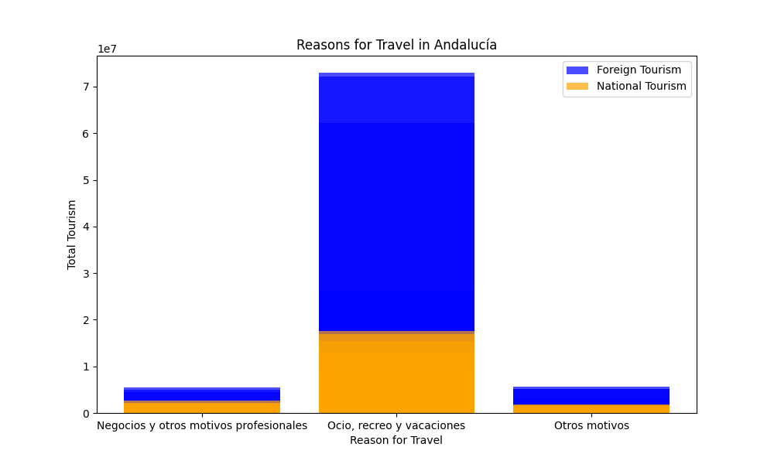
Type of trips in Andalusia

Slide 10
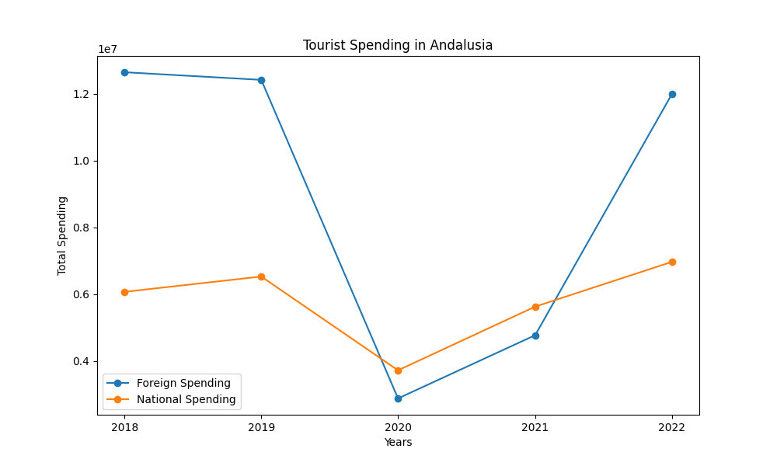
Tourist spending in Andalusia

Slide 11
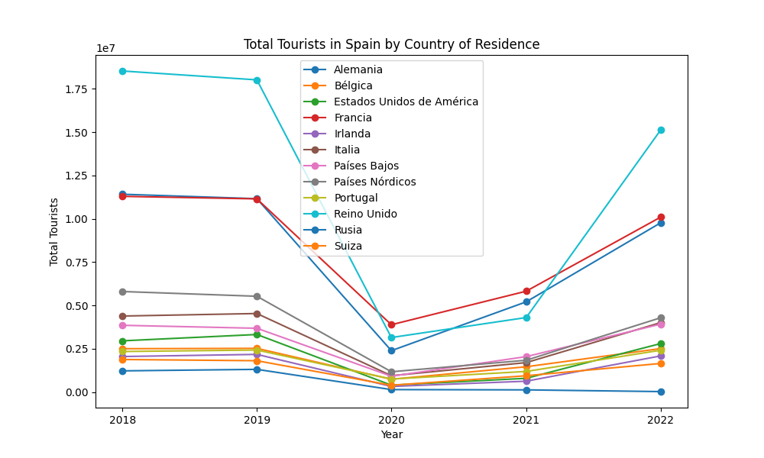
Foreign tourism according to origin

Slide 12
Thank you very much!

